Slide 1
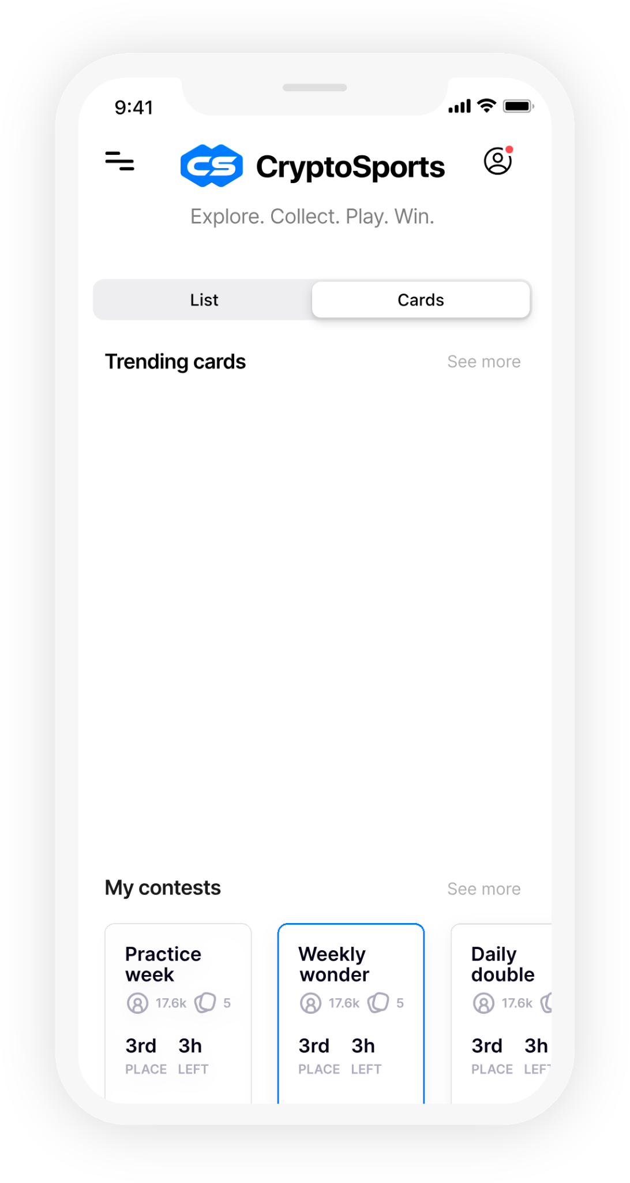
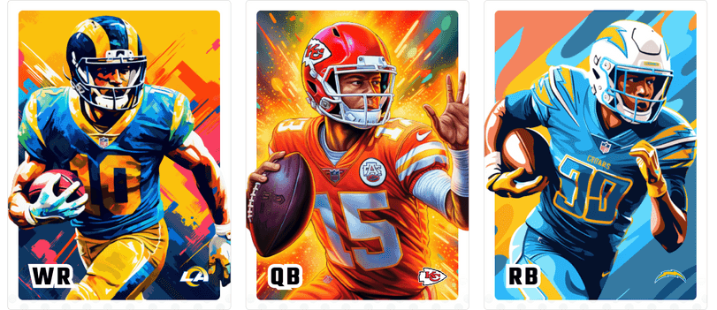

CryptoSports
THE DIGITAL COLLECTIBLES FANTASY SPORTS PLATFORM
2024

Slide 2
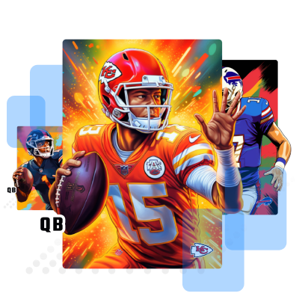

Agenda
Vision & Opportunity
Product & Platform
Customer Insights & Traction
Roadmap Ahead
Funding the Business
VC Pitch Deck
Notes:
Deep

Slide 3
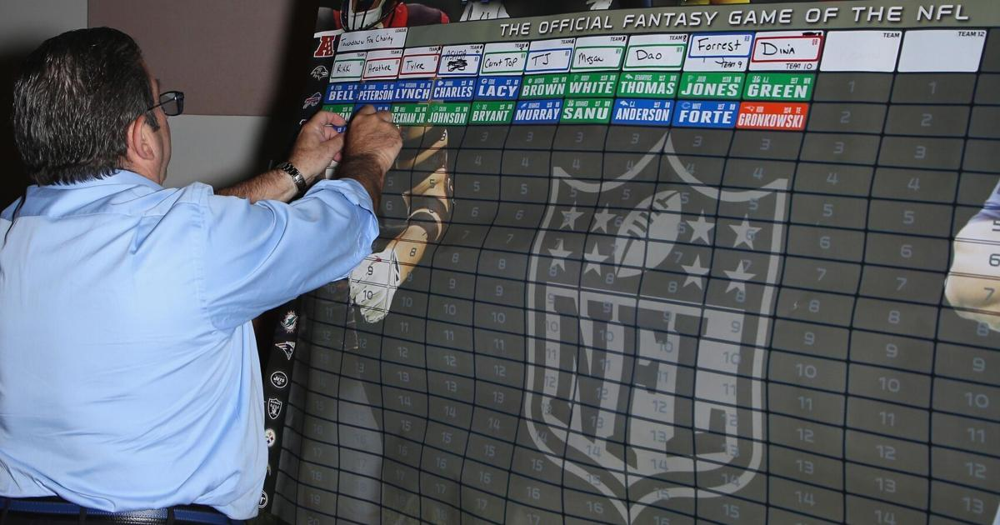
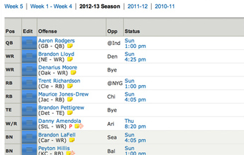
Fantasy hasn’t changed
IN 30 YEARS
VC Pitch Deck
Notes:
Deep

Slide 4
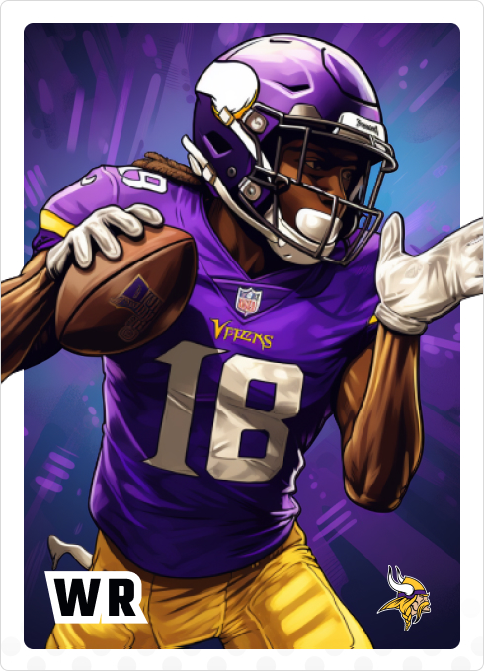
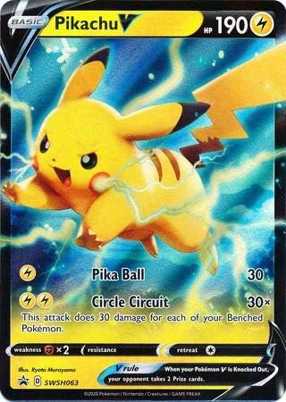
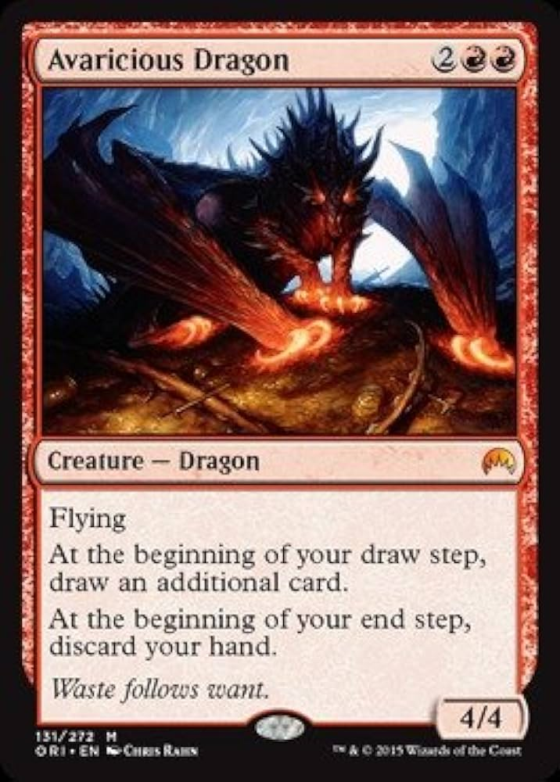

OUR VISION: NEXT GEN FANTASY
A new collectible-based, community-oriented fantasy game can emerge as the leading fantasy game for the industry at large –
Collectable-based, engaging consumers in-season and year-round. Collectables are a massive nascent, adjacent industry
Appealing to a younger demo, who have stronger gravity to play-when-they-want, collecting / forming digital presence & community
New digital goods transaction-based monetisation with verifiable ownership
Emotionally charged (remember keepers?)
Community based
VC Pitch Deck
Notes:
Deep

Slide 5
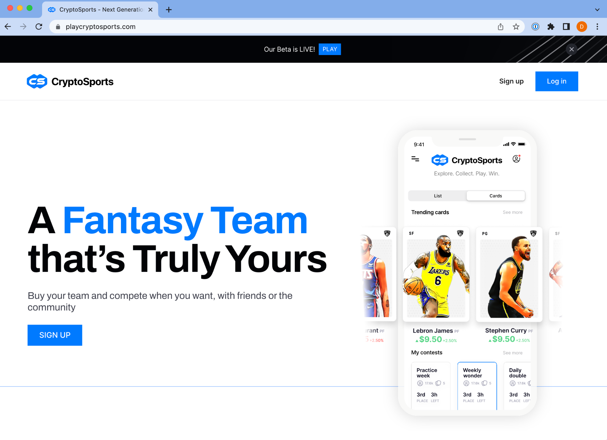
Mission
Vision
Make every sports fan an owner of a team
A space where fans and friends can genuinely collect and compete like real owners
VC Pitch Deck
Notes:
Deep

Slide 6
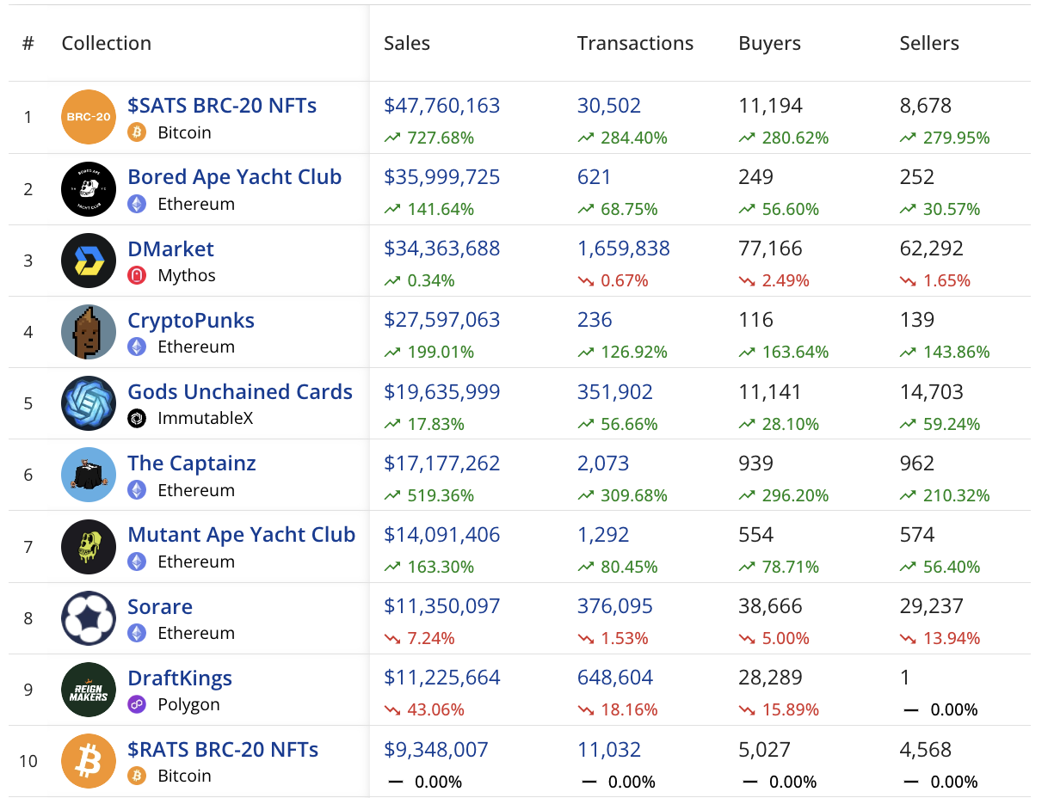
MARKET FIT
Sorare and Draftkings’ Reinmakers have demonstrated product market fit in collectables-based fantasy sports
L30 Days, as of 11 Nov
Sorare and Draftkings Reinmakers are both Top-10 digital collectable communities
30k - 50k active users
$11m revenue/mo each, and likely $1m net revenue/mo
Market big enough for multiple players
$350 spend per active player per month on Sorare or Draftkings Reignmakers
$7b size of global trading card market
VC Pitch Deck
Notes:
Deep

Slide 7
A new digital collectable game creates a new business model, built on a community-first culture
🃏 First-of-a-kind Collectable, Affordable, and Understandable Simple to understand and priced affordably – Sorare costs over $500 to field a competitive team Crypto Wallet fades into background…
🔮 Designed with the Consumer Community – Building what people want Two-way community conversation creates a passionate advocate group and ultimately builds a product consumers want
🔥 Reach Gen Z and Millennials Low commitment, come-and-go game style, untethered to season dynamics Expression through digital presence (Roblox, Minecraft, Discord)
BUSINESS MODEL RE-INVENTION
CONSUMER CULTURE
NEW AUDIENCE
VC Pitch Deck
Notes:
Deep

Slide 8



Tapping into underserved mass-market emotions
Collecting Remember that feeling of having a legendary keeper in your traditional league? Why not have that feeling all the time? Remember those trading cards – sports, Pokemon, Magic Gathering, you name it – you used to love and collect?
Sports Knowledge Flex your sports knowledge – buy them at the right times, or construct the right team – unlike an unlucky Fantasy draft – every day is draft day.
Community Be part of that exclusive club – the first group to have a voice in designing the next gen Fantasy platform
VC Pitch Deck
Notes:
Deep

Slide 9
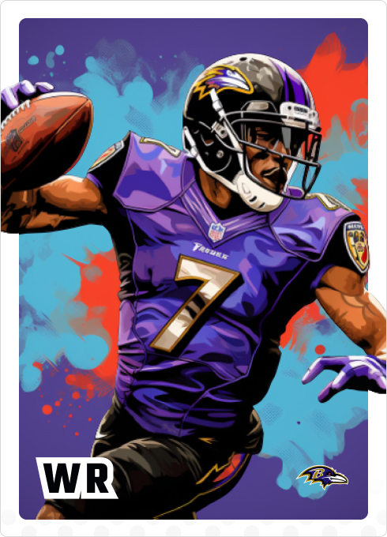


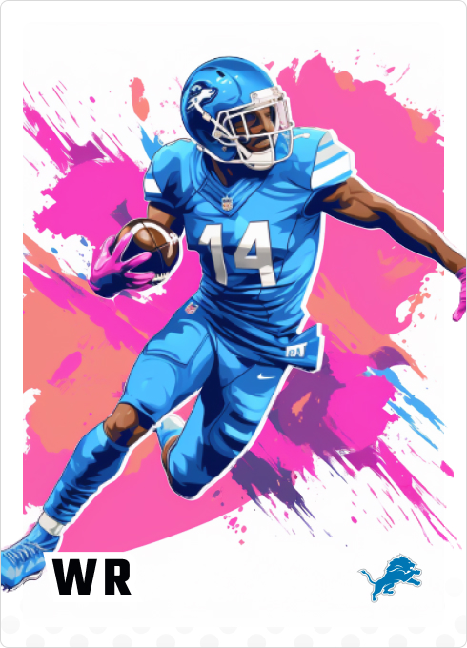
THE PRODUCT
7 SLIDES

Slide 10
CryptoSports differentiates with affordability (mass market) and maximum player utility – artwork and multiple game modes (metaverse)
 | CryptoSports | Sorare | Reignmakers | Fifa Ultimate
Audience | Casual, gambling curious | Speculators | Speculators and Gamblers | Casual Gamers
Cost | Priced affordable – for mass market | Expensive ($500 bankroll required) – for serious players | Expensive ($500 bankroll required) – for seriously players | Affordable
Artwork | Yes | No | No | Somewhat
Metaverse / Multiple game styles | Building now | No | No | Yes
Blockchain | Yes | Yes | Yes | No
Marketplace | Yes | Yes | Yes | Yes
Regulatory requirements | Low | Medium | High | Low
VC Pitch Deck
Notes:
TP
We’ve been really deliberate about what we’re building and why. This grid highlights CryptoSports against the competition. Sorare, Reignmakers and Fifa Ultimate, a card based video game NOT on the blockchain that does 1.62 billion/year.
- We’re targeting a broader mass market audience, that’s more similar to Fifa Ultimate. They love sports but are not the whale’s or hard core sports sharps – we’re calling them gambling curious.
- and we’re pricing our players so that it’s more affordable for the average person, and spending more similarly matches mobile games and CCGs (collectible card games)
- Our artwork is intentionally more fun and reminiscent of CCGs. - We’re innovating on the space by adding metaverse games for additional uses for the cards with a focus on collecting, sports knowledge and community/sharing on social media. Gridiron puzzle & draftmode top priorities - Doing these things significantly lowers our regulatory requirements and allows us to move with higher velocity

Slide 11
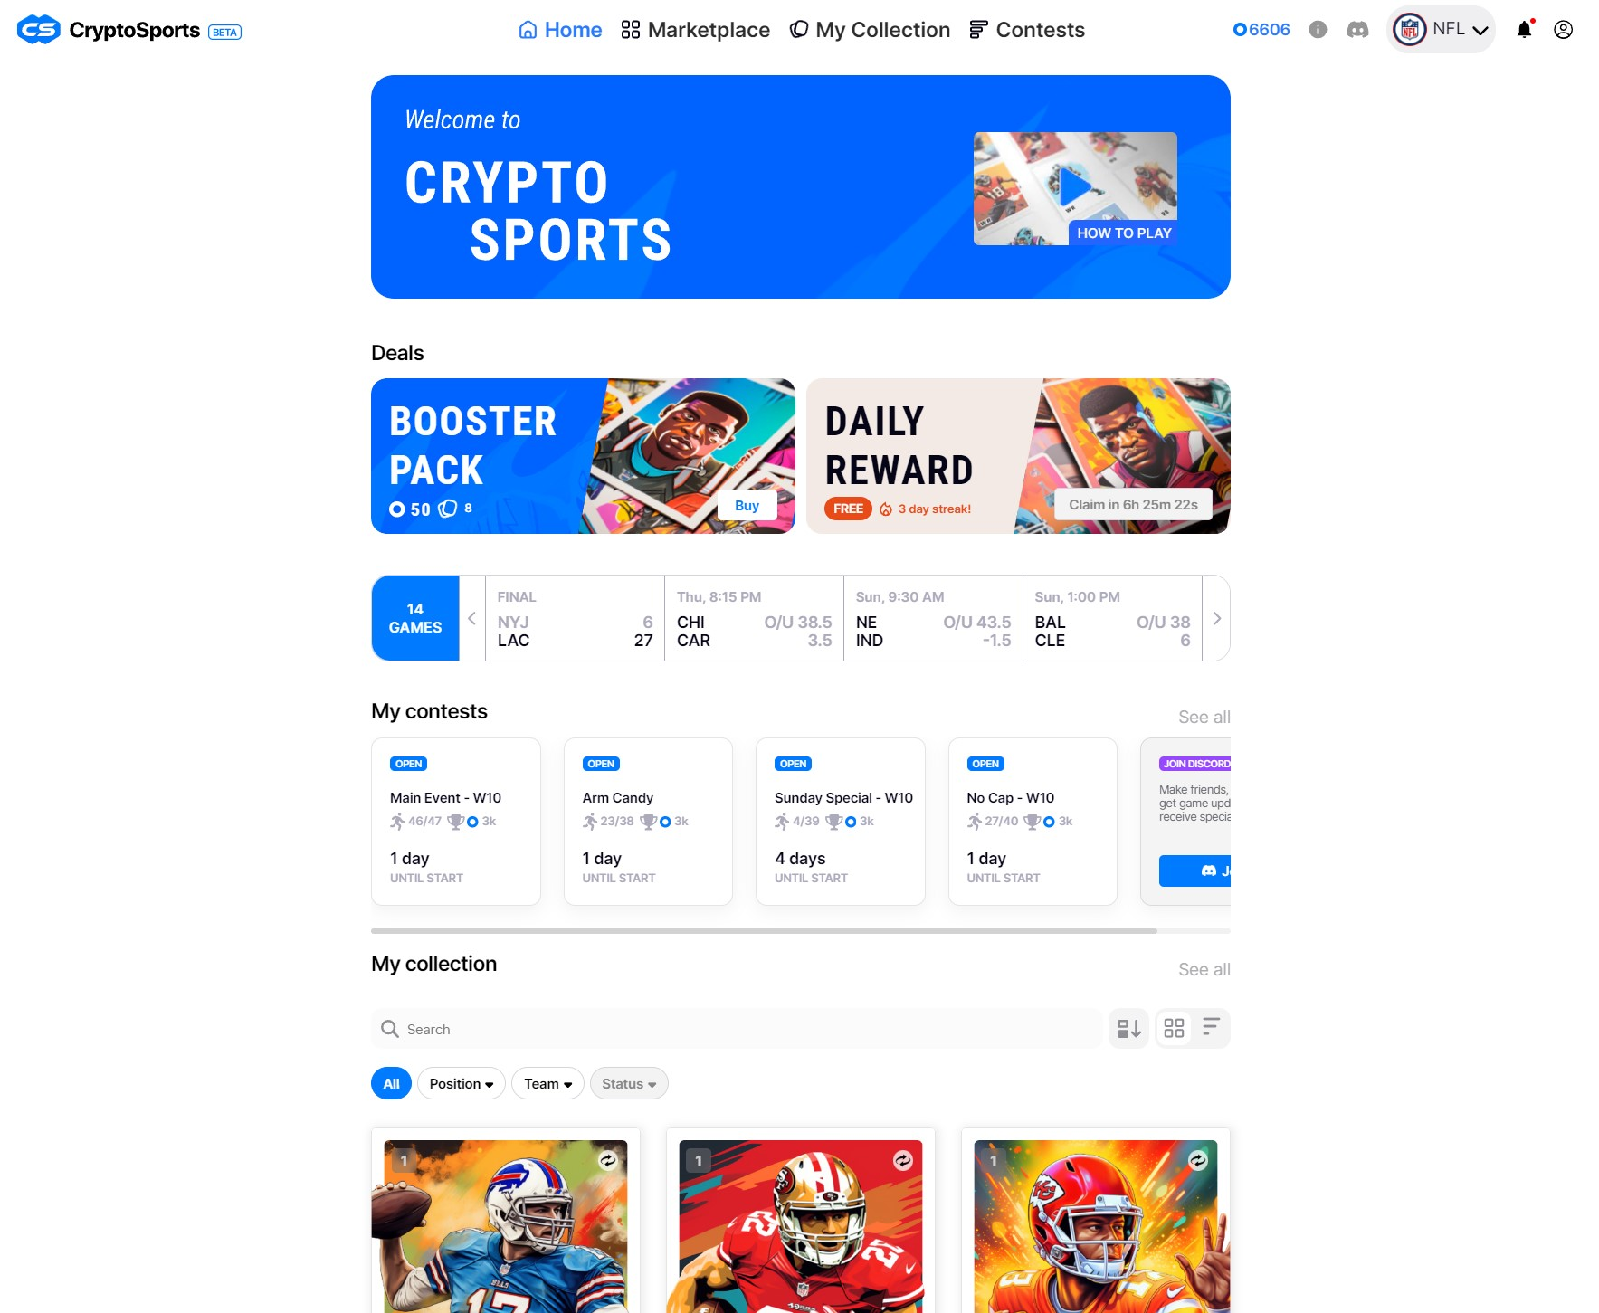
The Platform
We’ve built a platform to acquire, collect & play leveraging AI, blockchain and community technology
Blockchain-based collectables platform
Gasless blockchain wallet using Polygon
Peer to peer marketplace (buy, sell, search)
Pricing model
Fantasy game engine
AI-generated art
Active Discord community
White-labelable (multisport integration)
VC Pitch Deck
Notes:
MIKE
Quickly let’s recap on what we’ve built and what exists today. The web3 daily fantasy platform that allows users to acquire, collect and play in contests, has leveraged colorful and captivating AI art, and is built on the Matic blockchain to verify all market transaction.
Key points– Web3 integrated daily fantasy platform built on the polygon chain
Smooth and hassle free web3 experience
Seamless onboarding, custom account abstraction with custodial wallet
Gasless transaction so users have frictionless blockchain experience
Active discord with discord marketplace bots
Integrated scoring and API from sportsdata.io, including injury reports, and dynamic scheduling and rating
Validity of web3 with version 1 of the p2p marketplace with history of all transactions from users wallet remain on chain and able to be viewed on all permissionless marketplaces (i.e. opensea, blur) - reinforcing ownership

Slide 12
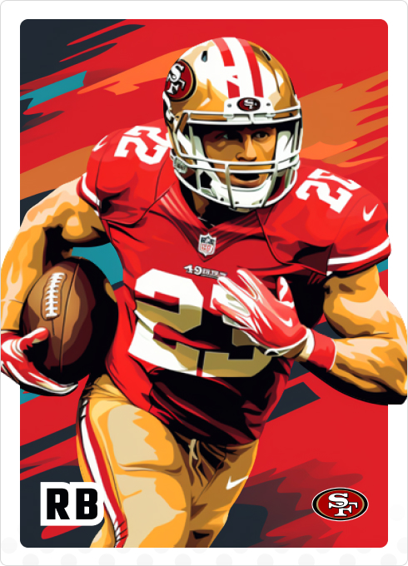
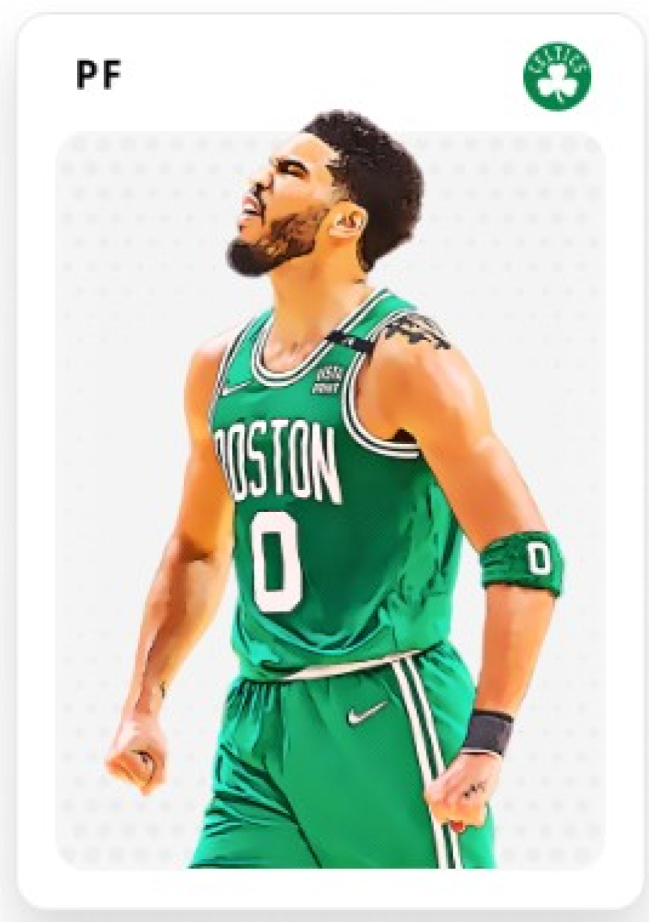
Significant accomplishments at velocity while running lean
NBA MVP - $350k funding
NFL APP - $400k funding
NEWSLETTER
GOOGLE ANALYTICS
NBA SCORING INTEGRATION
NFL SCORING ENGINE
DFS LEGAL RESEARCH
UX DESIGN
BASIC MARKETPLACE
USER ACCOUNTS
BOOSTER PACK & RARITY
NFL LAUNCH!
DISCORD HELP CENTER & ISSUE RESOLUTION
METAVERSE GAMING DESIGN & BUILD
DISCORD
COMMUNITY
ARCHITECTURE & STRATEGY FOR NFL
214 users
Q4 22
Q1 ‘23
Q2 ‘23
Q3 ‘23
Q4 ‘23
RL PRIZE DISTRIBUTION PROCESS
NFLPA APP SUBMITTED
PAYMENT PROCESSOR PARTNERSHIP
TODAY
100 users
NBA ART
UX FEEDBACK SURVEY
AI NFL ART
UX FEEDBACK SURVEY
BACKEND & FRONTEND BUILD
INITIAL NBA LAUNCH!
NFL SCORING INTEGRATION & UI
LONG TERM TOKENOMICS PLAN
SMART CONTRACTS
NOTIFICATION CENTER
FULL SUITE TESTING ENV
VC Pitch Deck
Notes:
Ti We’ve make significant accomplishments at velocity while running lean.
It’s been around 12 months from today we started. The first 350k allowed us to: - design and build the NBA MVP
Onboard the first 100 users
Take in feedback and architecture a detailed strategy for NFL
Have players who were PAID, and they stuck around and played for the fun of it and the prizes this time around.
The second round of funding allowed us to
Build the NFL scoring engine with new art
Move to booster pack model
Launch for the first day of the NFL season
Grow to 214 users
And today we have a clear pathway to become a revenue generating business

Slide 13
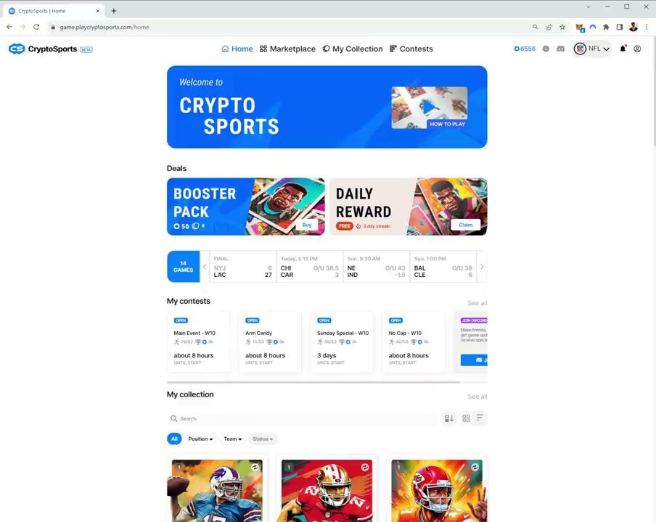

Key Game Capabilities
Packs create surprise and repeat usage
Daily rewards create repeat usage and utility
VC Pitch Deck
Notes:
Ti
“I think I got the world record for the Daily Streak. 48 days of perfection.”

Slide 14
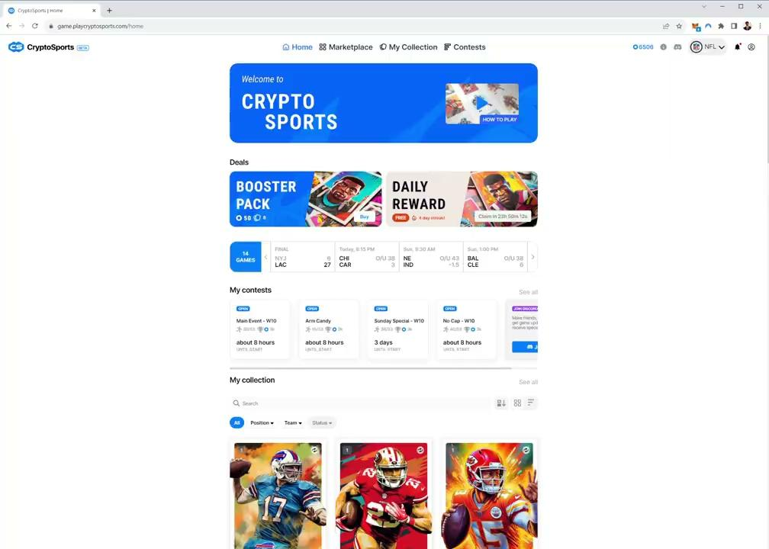
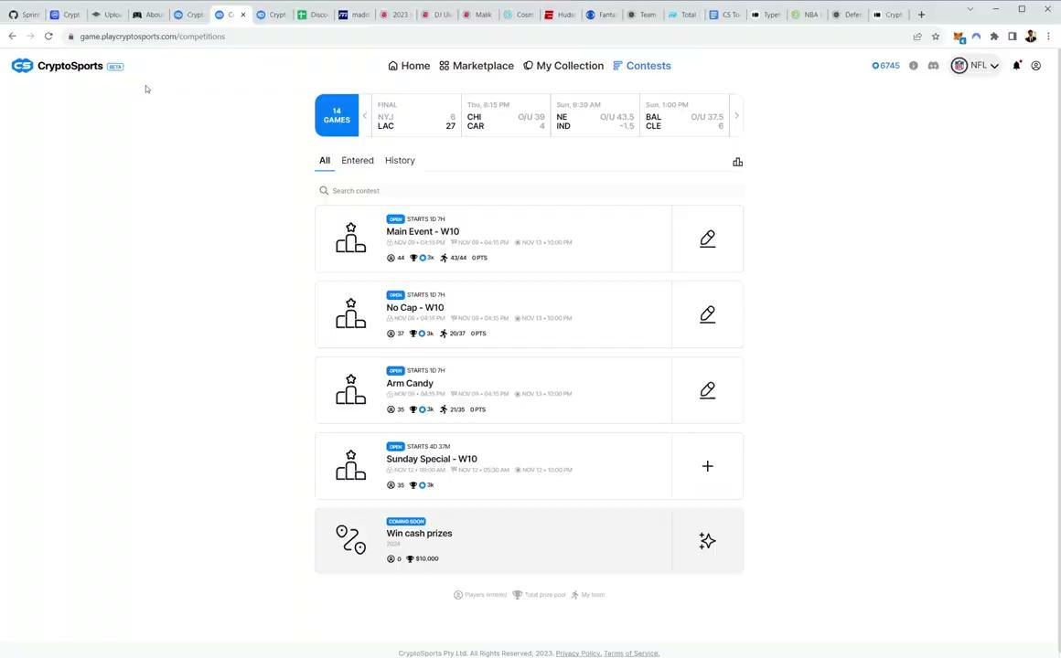
Key Game Capabilities
Marketplace provides instant gratification and liquidity
SEARCH / FILTER / BUY / LIST / SELL
Build Lineups & Live Fantasy Scoring
VC Pitch Deck
Notes:
Ti

Slide 15
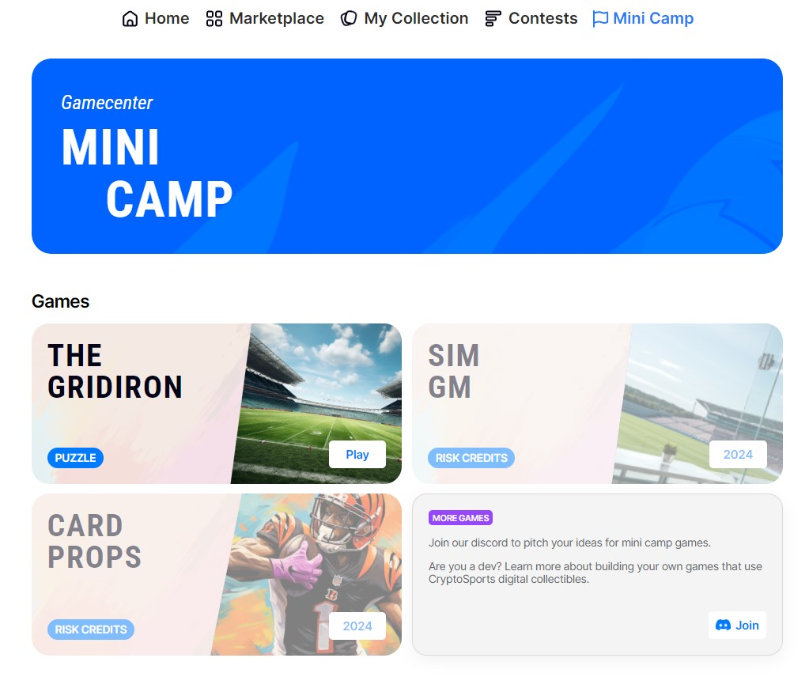
Key Game Capabilities
Gamecenter:
Provides activities during non game hours
Transitions users to gambling games
VC Pitch Deck
Notes:
Ti

Slide 16
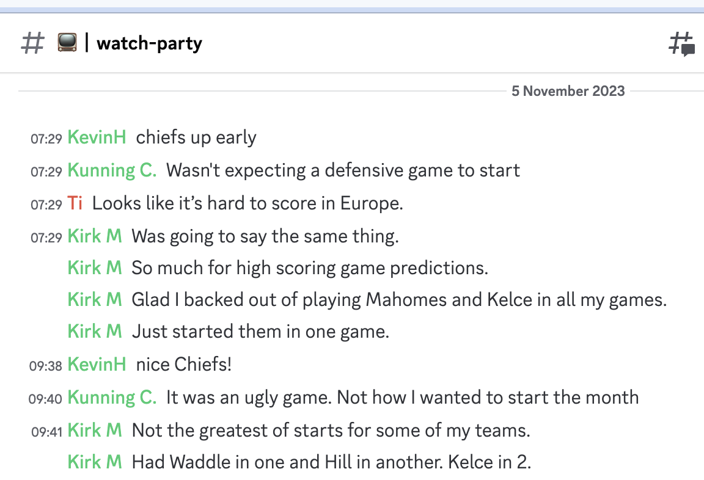
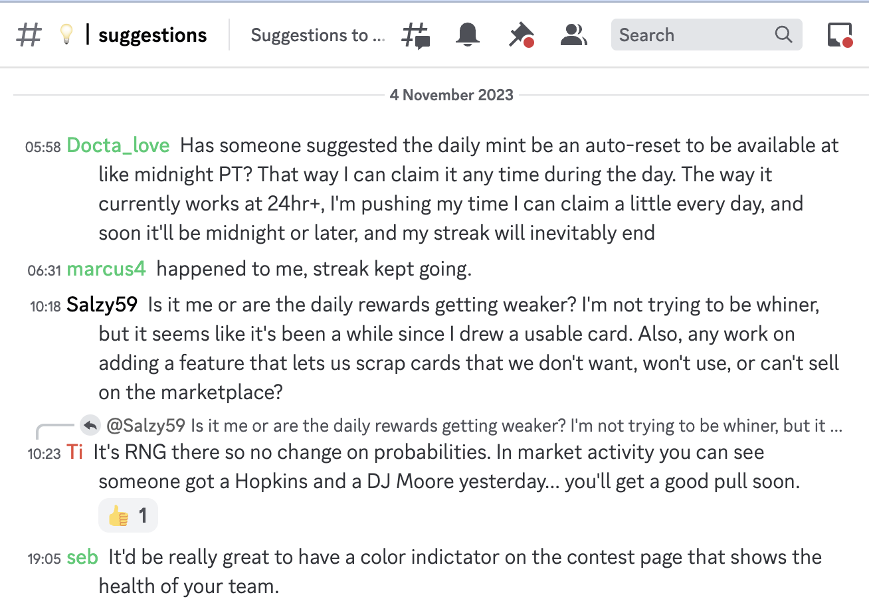
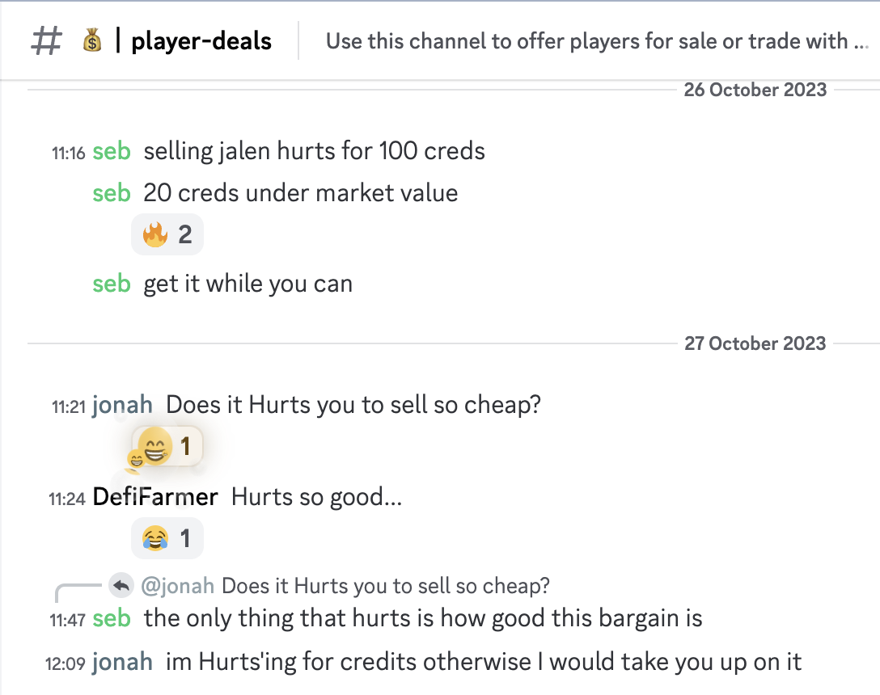
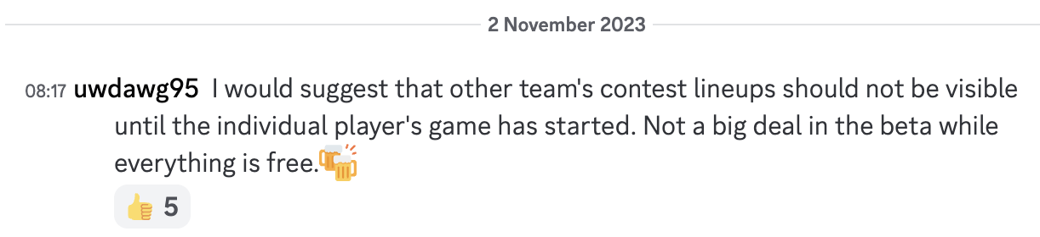
Engaged community
Active Community
…providing feedback and input
VC Pitch Deck
Notes:
TI
We have a hyper engaged community that we manage in discord and we have a community manager that interacts with them daily.
We’ve organized them in discord so that specific channels delineate topics.
They use it to:
watch football games together
Talk about trading players with each
And provide bug testing, suggestions, ideas and input

Slide 17
7 Passionate Team Members
7 core members
Essential subcontractors
Game design & economics
Community management
Product management
Software engineering
Product Design UX & art
Business, licensing & legal
Community manager
UX Design
Tokenomics consultants
Legal
ZWill
Peter Luce
VC Pitch Deck
Notes:
Ti And we’ve done this with 7 passionate team members who have the ability to dive into this full-time
Committing to it for multiple years, once funded

Slide 18
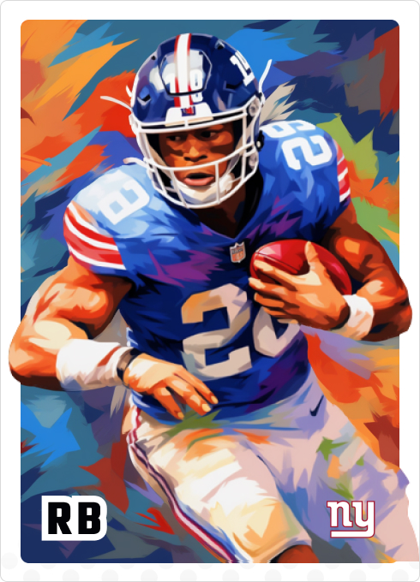
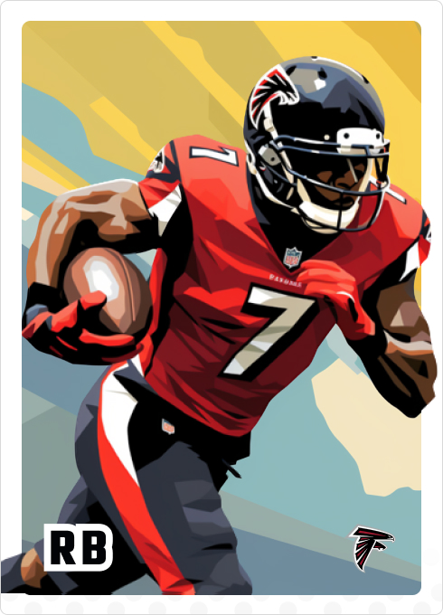
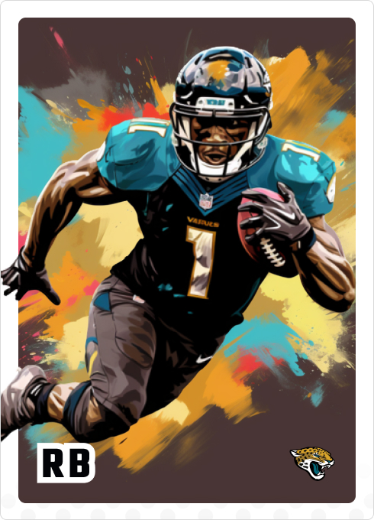
TRACTION - CUSTOMERS
5 SLIDES
Notes:
Let’s get into the current users and start with the survey showing how they are responding to the experience.

Slide 19
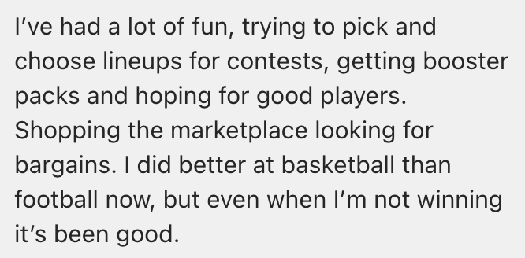
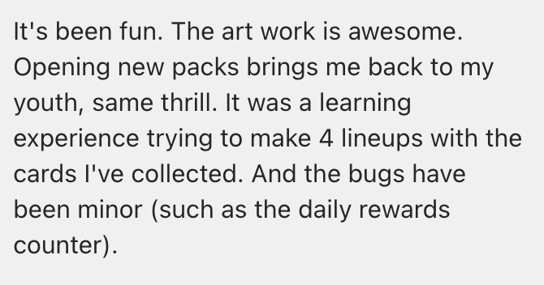
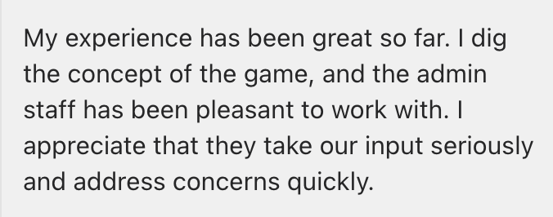
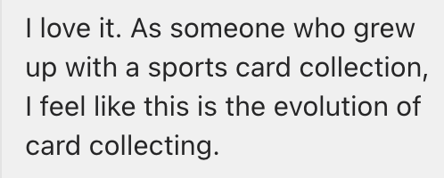
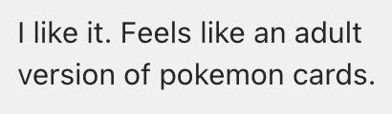
Customers are receptive to pay, play, & recommend the game
Key Takeouts
7.4 / 10 overall satisfaction with the game
8.1 / 10 sentiment around owning players
8.3 / 10 willing to recommend to their friends
7.0 / 10 sentiment towards the Discord community
95% think of Crypto Sports in addition to fantasy
40% willing to pay to acquire and manage their team
Survey Results
VC Pitch Deck
Notes:
Ti
We’ve pulled some of the key takeaways from the survey here. This went out to all 215 users and we ended getting about 80 responses. There’s also a link below that you can review in more depth offline.
…go over key takeaways
Ultimately we’re seeing that customers are receptive to pay, play and recommend the game.

Slide 20
User Feedback (cont’d)
DarthRosie “I need 7 coins to mint Puka Nacua. I figured I would pick up some of these younger guys for cheaper and hope they do something over the next few years too.”
Minting to the Finish Line “I think the trading markets could be really engaging… a differentiator from other fantasy leagues would be the ability to adapt to market conditions.”
Pandasmonkey “I’ve never been a part of anything like this. You guys did a great job setting this up. I’m having fun already and I haven’t even played yet.”
Black Hawk Down “I just want to let you know that I am really enjoying Crypto Sports, and cannot wait the new things you guys are preparing for us.”
Wolfpack “Thanks for having this amazing contest!!”
DarthRosie “It looks like you have an NBA tab too, I would play that too… I think this is pretty cool. It’s like a Dynasty League mixed with a Draft Kings feel.”
Kirk M “Really want this idea to take off. Think it is a cool idea.”
VC Pitch Deck
Notes:
Ti
We’ve pulled some quotes and interactions here that we found significant. Two I want to highlight:
DarthRosie: Players interested in finding value and collecting for multiple seasons
Wanting to play multiple sports like NBA

Slide 21
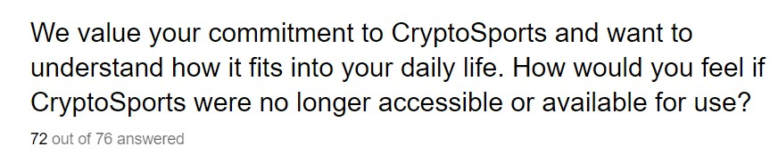
User Feedback (cont’d)
Sad
It would be extremely disappointing as it is part of my weekly routine
I would be really bummed. This has been a nice little treasure to find and will begin spreading the word about it soon. If you need someone to help market it, I'm your guy!
Disappointed. Enjoy the new gameplay
I would truly be missing the game and would be bummed that I couldn’t play anymore
It’s become a fun system that I check and mess around with daily.
Disappointed
Would miss it, but there are other options available
I would be disappointed, but not devastated. It's cool and fun, but I don't need it to live a full life.
I would be sad. I have come to really enjoy this and wish I could play for basketball as well. It’s been really fun. It’s help me really get to know players more. It’s been fun and I look forward to every football game.
I have mixed feelings. I was happy about it at the beginning. But it's the holidays, longer work hours.... that's why I need more frequent reminders, which I'm not getting.
It's different and gives me another option besides fantasy football.. Id be bummed as I'm just getting the hang of it
I would be very disappointed if it was no longer available. I enjoy getting my daily rewards, seeing what cards of mine sold on the Marketplace, buying booster packs and figuring out my lineups.
I'd miss the platform for a few weeks/months since logging in for the daily reward has become a habit.
Just a little disappointed
VC Pitch Deck
Notes:
Ti
Strong negative reactions to a question about the app no longer being accessible

Slide 22
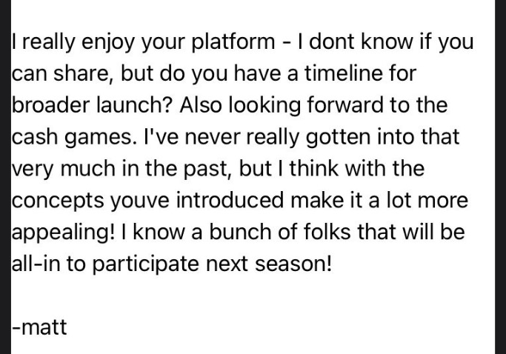
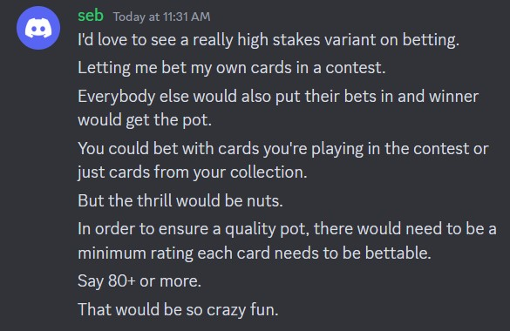
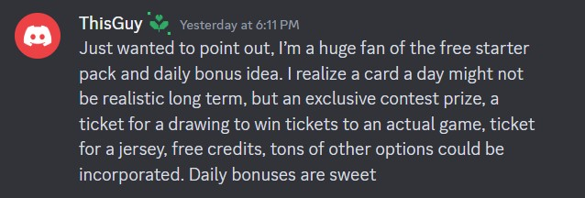
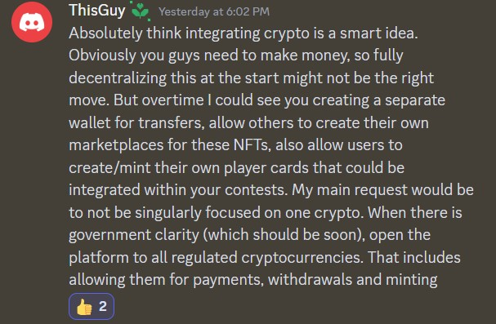
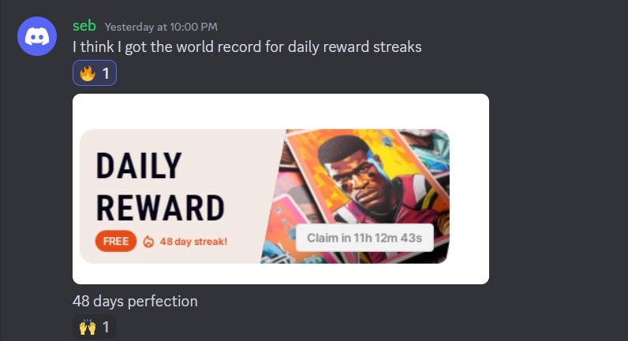
User Feedback (cont’d)
VC Pitch Deck
Notes:
Ti
Examples of high level feedback that we’ve gathered, logged and often used to enhance the site

Slide 23
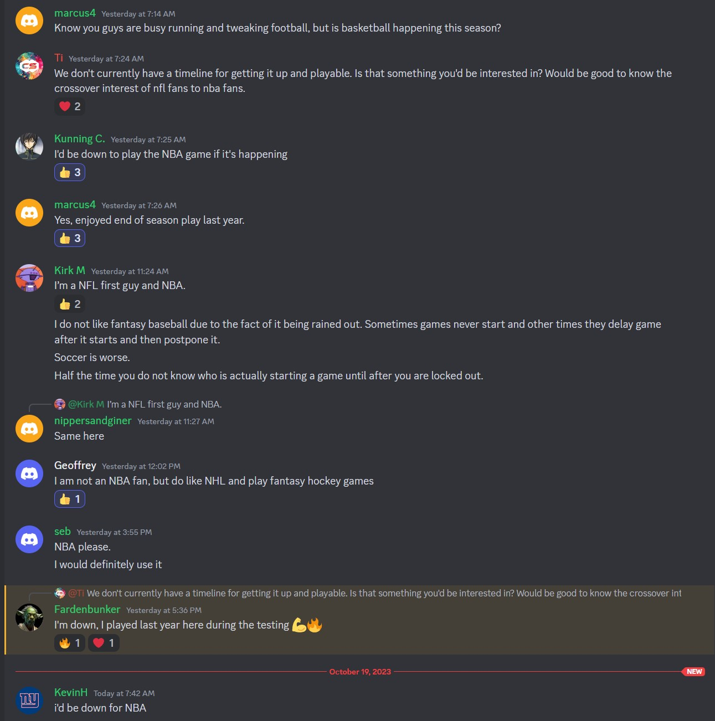
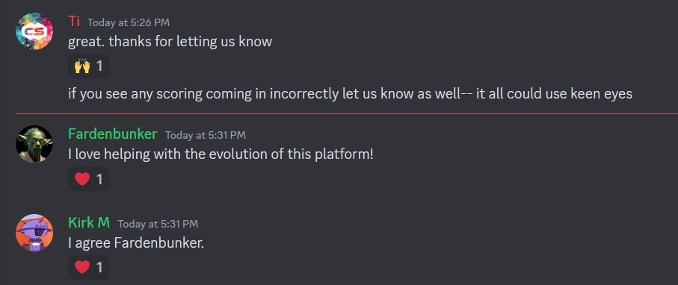
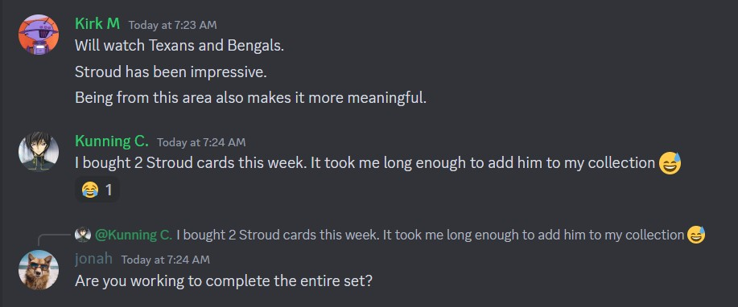
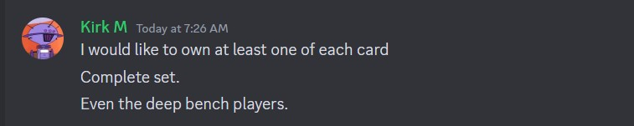
User Feedback (cont’d)
VC Pitch Deck
Notes:
Ti
What’s interesting for many is that they really enjoy it and feel like they’re part of the team

Slide 24
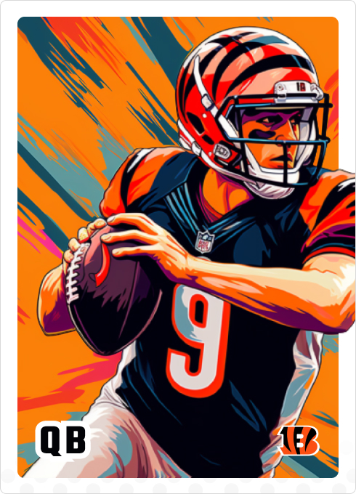
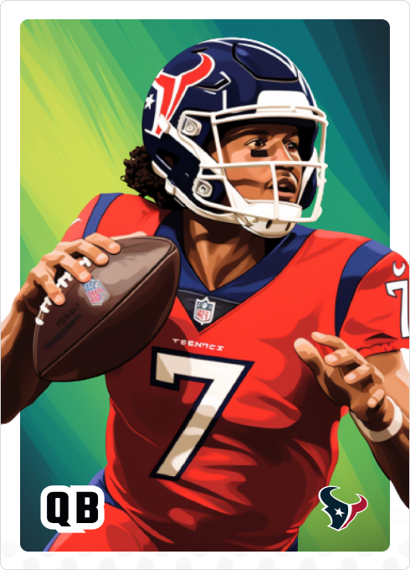
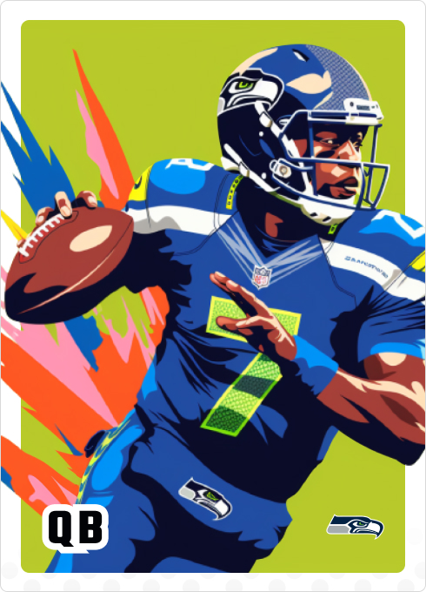
TRACTION - DATA
4 SLIDES

Slide 25
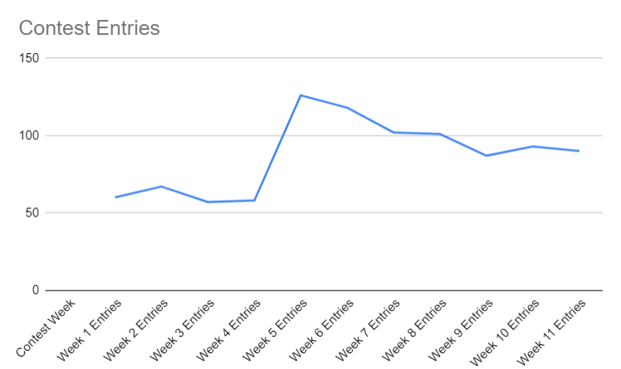
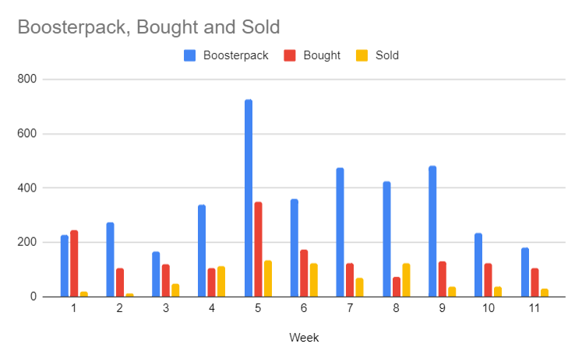
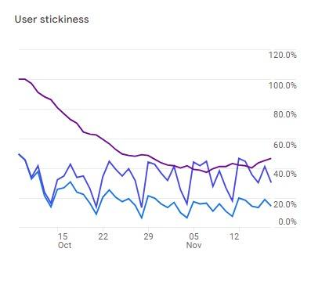
Strong Continued Engagement Week-to-Week (pool of 220 users)
Good retention in Weekly Contest Participants
Sustained Weekly Marketplace Transactions
Daily Usage spread throughout week – except Saturdays
Paused user acquisition after week 6
VC Pitch Deck
Notes:
Mike
Customer retention across contests even as we get closer to play offs
Very clear daily use lining up with NFL cadence
Initial mass sale of booster packs at the start as new users are building lineups
Drop of booster packs purchased is due no more new users being on border and most players being unlocked, but we have seen a constant purchasing of single cards in the marketplace. As the season eveloves and players change ratings and standings during the season progresses.
Avg engagement time: 12 min 45 sec
From UX Team:
Total surveyed- 63,759
Actually sent the sign up link - 1631
Barrier of entry (sign NDA) that made this number a little lower

Slide 26
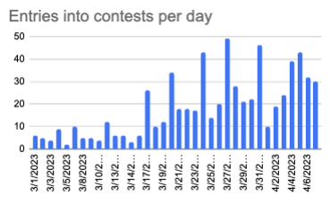
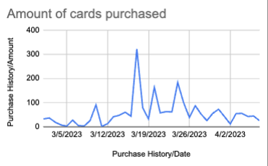
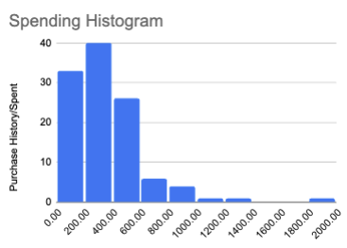
… and our NBA from Q4 game saw similar trends of sustained users
$338 Virtual Dollars Spent on cards Per player in NBA*
VC Pitch Deck
Notes:
Mike
Saw similar action across our beta NBA offering with individual card purchases
Stable contest activity
Large number of cards purchased at the start then a constant purchase of individual cards are the season goes on

Slide 27

Who are the ‘hardcore’ users?
21% of Users
Income:
26.7% 10k-50k,
36.7% 50-100k
16.7% 100k+
Trading cards: 80% collected trading cards growing up but just 26% do now
DFS Spending:
51% spend on DFS, and of those 12% spend $50-99 while 41% spend $150+
VC Pitch Deck

Slide 28
Evolving purchasing to drive immediate gratification and ongoing commitment
Two main methods for spending dollars into the system will increase daily activity through the duration of season, instill consumer loyalty and maximize the bottom line
Rewarding One time purchases
Committing to Season long packages
Users will receive bonuses for depositing large amounts. We will offer deposits at several pricing tiers.
100 credits - $5
500 credits + 50 credit bonus - $25
2000 credits + 400 credit bonus - $100
Users will pay a single up front cost while receiving benefits spread out across the entire season.
Our $50 membership perks will include:
8 booster packs up front ($20 value)
300 credits ($15 value)
18 booster packs released at a rate of one per week ($45 value)
Weekly member only freeroll contests
Special season long member collectible
+
=$60
Avg spent on cards per paid user in 1st month NFL
$30/mo
Avg spent on cards
after that
VC Pitch Deck
Notes:
Mike
Goal is to keep users engaged through the season
Our future plans for collectibles to increase utility and tokinomics that will drive season long engagement with many more contests, and game types that will drive purchases of more booster packs and marketplace participation
Bonuses for larger deposits to obtain credits and bulk purchases of booster packs through draft games and membership perks
We estimate that we are going to be able to get $60 per users for the start of the season to acquire the initial collection + 30 to 60 for enhancements based on survey data

Slide 29



ROADMAP AHEAD
3 Slides

Slide 30
The next funding round would transition from game concept to a compliant, revenue-generating US business
Accept & Distribute Payments
Generate Card Utility
The Metaverse
Licenses and Compliance
Distribution
Have selected and been approved for payment processor – ready to implement
Continued investment in compelling artwork
More Games – Gridiron Puzzle, Simulation Game
More Sports – Relaunch NBA
Application with NFLPA in progress – may not be needed if we learn on artwork, pending legal opinion
Incorporate as US business – with new name
Ready for mass scale distribution – need to stack hands on aligned distribution model
VC Pitch Deck
Notes:
Deep - Get payment online for the start of the 2024 NFL season
- Securing Licensing
- Building a fully fledged sports metaverse creating engagement and utility for the collectables through the season as well as allow for nature networking effects that are native to web3 collectables, i.e community building new experiences for each other, through fandom, and open source moder models that have been around in gaming.
- Strong partnership with Yahoo to bring this new experience to exciting sports user base

Slide 31



New games like Gridiron Puzzle create more utility for card ownership
GRIDIRON PUZZLE
VC Pitch Deck
Notes:
Deep
The first metaverse game “Gridiron Puzzle” we have built and are planning on sharing with the community next week

Slide 32





New and Different Artwork create more utility for buying and owning cards
VC Pitch Deck
Notes:
Deep
We are going to focus on the collectibility of each card sets and release multiple versions (rarity tiers) of cards each year and new collections with each season

Slide 33
FUNDING

Slide 34

12 month tech build out
VC Pitch Deck
Notes:
Mike:
Key development milestones we need to hit for the 2024 NFL season
Implement payment for credits
Upgrading Account abstraction for larger scalability and throughput
Version 2 of the marketplace with full bid ask and trade feats
Expanding on the user experiences to other games and daily challenges to offer utility for the cards all season long as well as the off season.
Sports store for credits to be used for prizes
Admin ops portal to better service customers and allowed the hiring of non technical admins to service and support day to day activities on the site.
- Ready for onboarding and payment during Aug preseason
Build a mobile app in parallel to the web app - 60% of users are using the app on their mobile phone.

Slide 35
CryptoSports
THE FANTASY SPORTS COLLECTIBLES PLATFORM
A collectible gaming ecosystem with verifiable ownership on the blockchain.
THANK YOU

Slide 36

Flow of funds model
CryptoSports Q4 Update

Slide 37



Newsletter stats
CryptoSports Q4 Update

